Slide 1

Your success is our success
Explore & Understand Rest API
- API Assignments 05
Funny Gorilla诙猩猩-IT培训

Slide 2
Prerequisites:
Gitbash (for Windows only)

Slide 3
Targets
Learn how explore and understand a REST API
Use cURL command line tool to invoke API endpoints

Slide 4
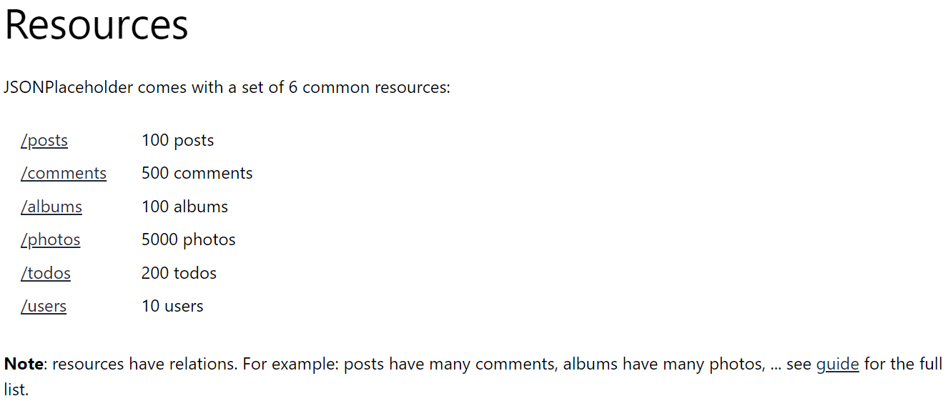
Target API – JSONPlaceHoder
https://jsonplaceholder.typicode.com/

Slide 5
Steps
Step 0: Invoker API Endpoints by cURL
Step one: Define business entity relationship
Step two: Map out API Endpoints, http verb, status code
Step three: Invoker API Endpoints by cURL

Slide 6
Reference
https://www.baeldung.com/curl-rest
https://everything.curl.dev/http
https://www.booleanworld.com/curl-command-tutorial-examples/

Slide 7

Your success is our success
Contact
Mail: info@funnygorilla.com.au
Linkedin: https://mt.linkedin.com/in/songqing-gu-2ba9034b/de
Web Chat: FunnyGorilla
Phone: 0420891343

